Slide 1
Projectile Motion

Slide 2
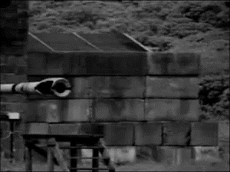
After completing this Smart Lesson you will be able to:
Describe the vertical motion of projectiles.
Perform calculations of vertical projectile motion.
Describe the horizontal motion of projectiles.
Perform calculations of horizontal motion of projectiles.

Slide 3
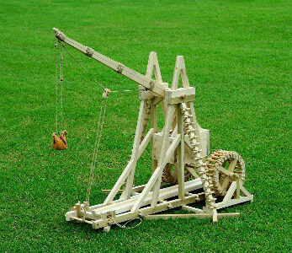
In this lesson we will be learning about projectile motion in the context of a trebuchet.
A trebuchet is a weapon of war that uses a swinging arm to throw a projectile. The Warwolf is believed to be the largest trebuchet ever built. It was used to destroy the curtain wall of Stirling Castle during the Scottish Wars of Independence.
The Warwolf intimidated the Scots so much they tried to surrender. King Edward I destroyed the castle anyway.

Slide 4
Vertical Projectile Motion An object that's thrown up slows down to a stop, then falls back down. The vertical acceleration of the object is always 9.8 ms⁻² downward due to gravity.

Slide 5
The projectile accelerates downward at 9.8 ms⁻². The projectile is thrown into the air with some initial vertical velocity. The vertical velocity of the projectile decreases as it is slowed down by gravity. The projectile stops in mid air, then speeds up in a downward direction as it falls back to the ground.

Slide 6
The velocity has the same size at the start and end of the motion, but the object is travelling in the opposite direction.

Slide 7
The time it takes for the object to reach maximum height, and the time it takes to fall back down are the same.

Slide 8
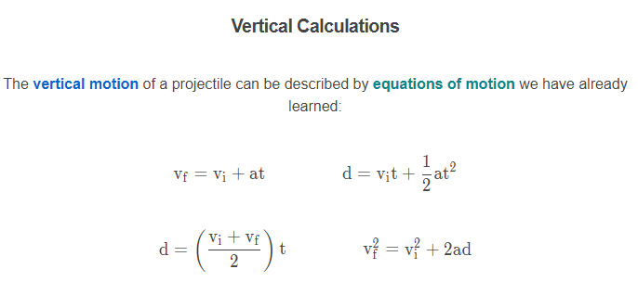

Slide 9

Example
Trebuchets were often used to throw flaming barrels over the walls of castles. The barrels would break open when they hit the ground and set fire to homes and stored food within the castle.
One barrel is launched into the air with an initial vertical velocity of 15 ms−1. How much time passes before the barrel lands inside the castle?
Of course, objects thrown by trebuchets travel horizontally as well. This will be covered later in this lesson.

Slide 10
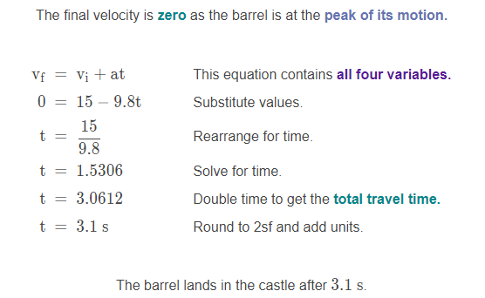
Solution
Calculate the time it takes for the barrel to reach the peak of its motion, then double it.
We know the initial velocity (15 ms⁻¹), final velocity (0 ms⁻¹), and acceleration (−9.8 ms⁻²). The unknown is time.
The final velocity is zero as the barrel is at the peak of its motion.

Slide 11
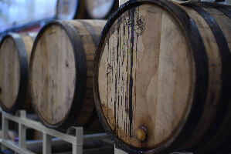
Example
What is the maximum height reached by the barrel in the previous example?

Slide 12
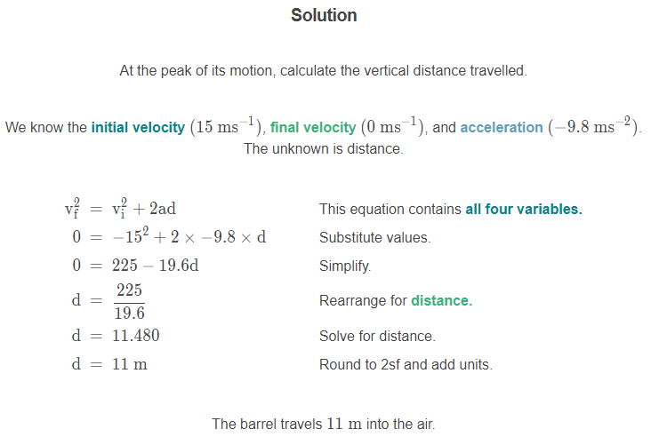

Slide 13
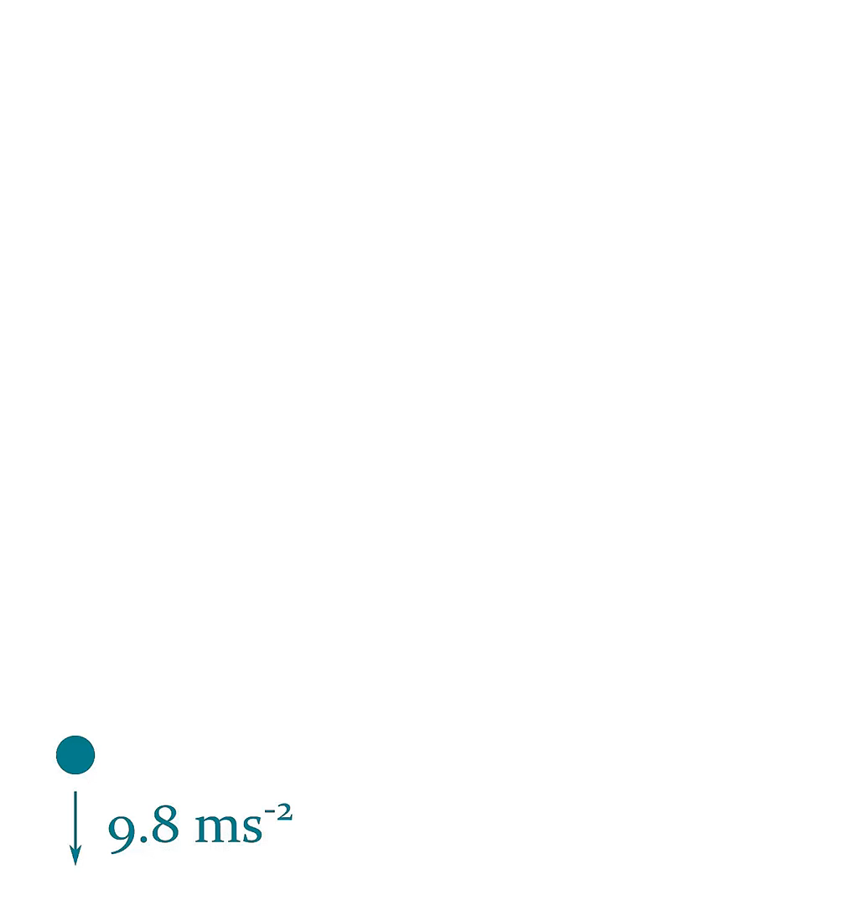
Horizontal Projectile Motion
When an object is fired at an angle there are both horizontal and vertical components to the velocity.
The vertical component is affected by gravity, while the horizontal is not.

Slide 14
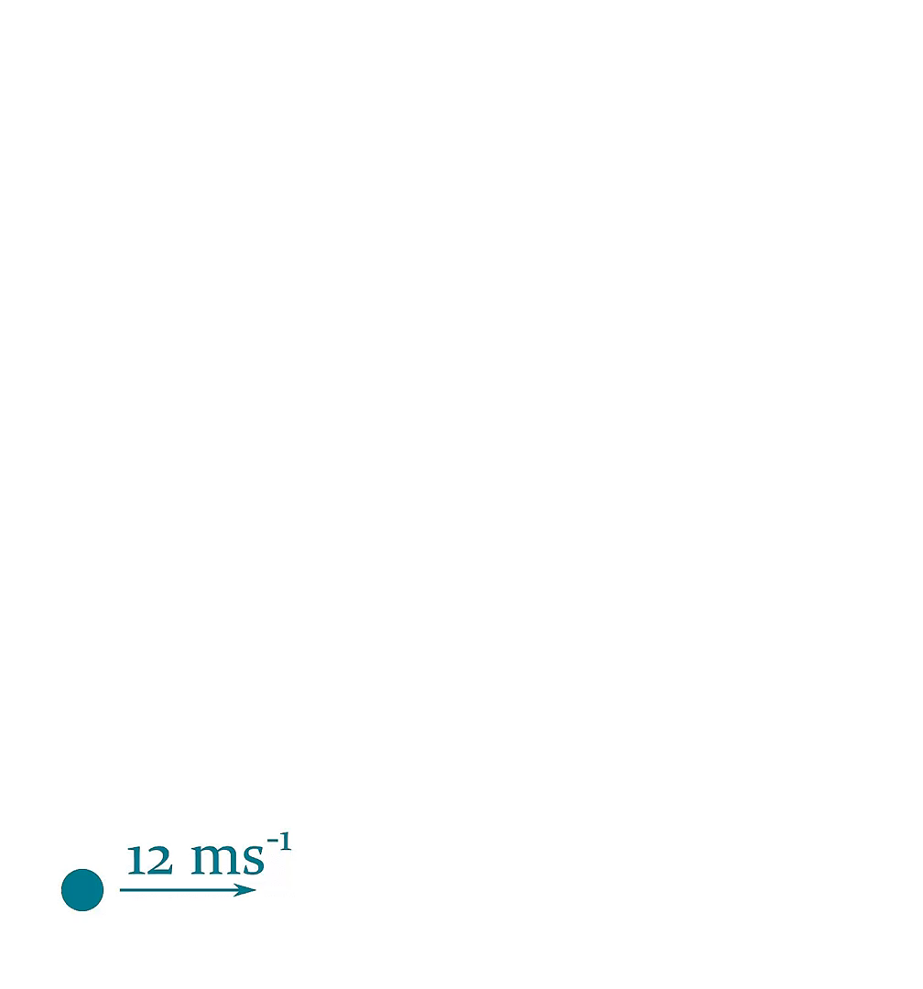
An object that is thrown diagonally instead of upward will continue to move sideways as it reaches maximum height, and falls back to the ground.
The horizontal velocity of the object stays constant, as there is no horizontal acceleration.

Slide 15

The time it takes for the object to reach maximum height, and the time it takes to fall back down are the same.
The object has travelled half of the horizontal distance (d/2) when at maximum height.

Slide 16
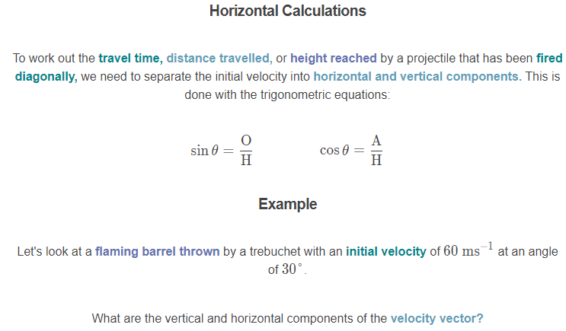
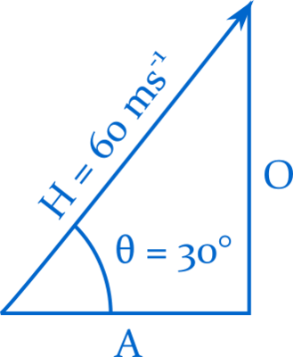

Slide 17
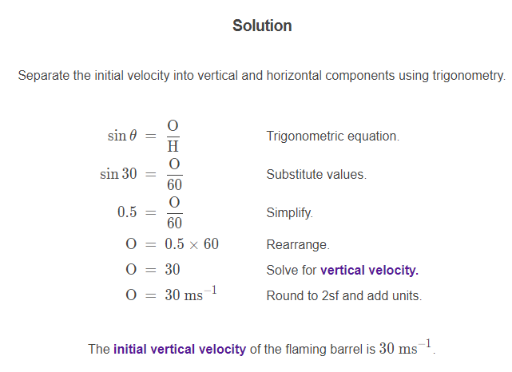

Slide 18
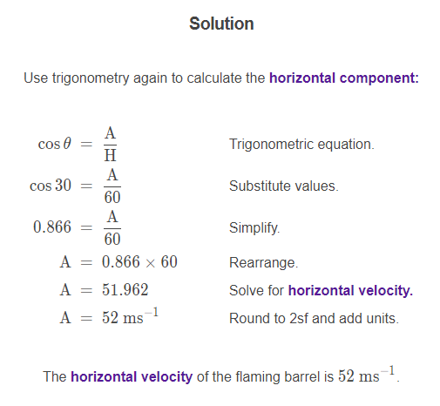

Slide 19
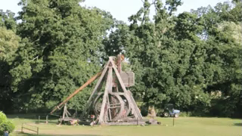
Example
The initial vertical velocity of the flaming barrel is 30 ms⁻¹ and the initial horizontal velocity of the barrel is 52 ms⁻¹.
How long is the barrel in the air?

Slide 20
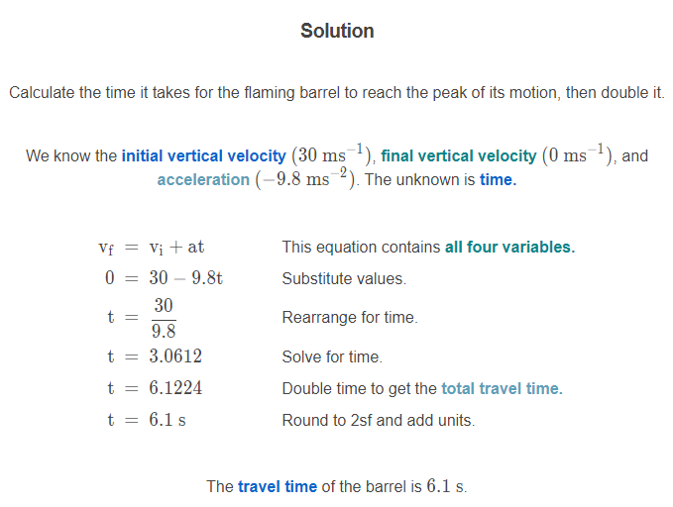

Slide 21
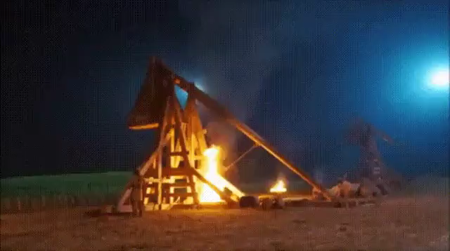
Example
What is the horizontal distance travelled by the flaming barrel?

Slide 22
